Slide 1
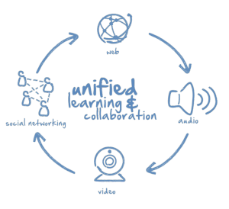
Elluminate
Ghania Zgheib
EDIT 611
Spring 2011

Slide 2
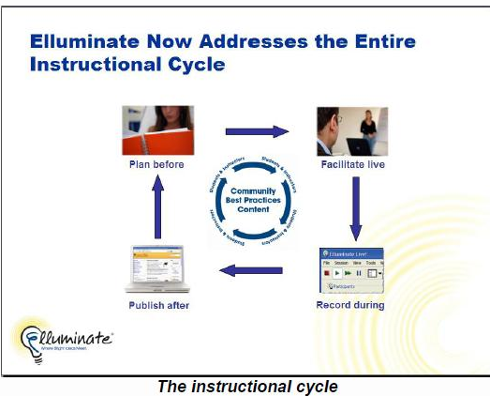

What is Elluminate?
A web conferencing program that provides the following programs:
Elluminate Live!
Elluminate Plan!
Elluminate Publish!
Elluminate Bridges

Slide 3
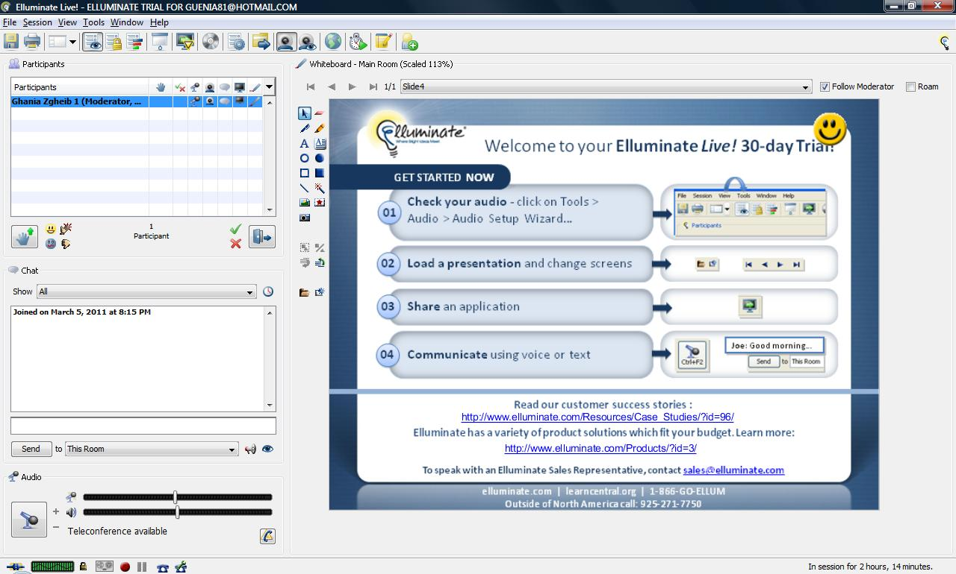
Elluminate Live!
Web tour
Participants room
White board
Chat room
Audio participation
Session recording
Teleconferencing

Slide 4
vSpaces
Elluminate vClass: 50-400 students
Elluminate vOffice: 50 participants
Elluminate vRoom: 3 participants (no recording or integrated teleconferencing)

Slide 5
Accessibility
Integrated closed captioning
Multi-stream video for ASL
Inherited OS display settings
Support for screen readers, including availability of slide text
Scalable content areas
Command-line access and shortcut keys
Personalized settings saved for next sessions

Slide 6
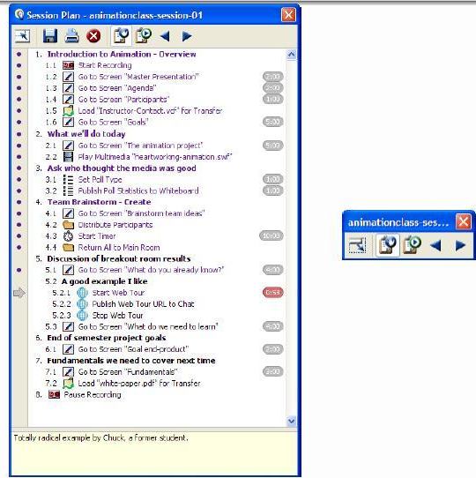
Elluminate Plan!
Add file
Add action
Add text
Add topic

Slide 7
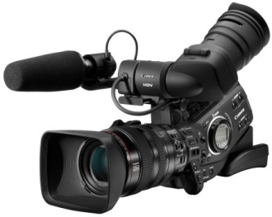


Elluminate Publish!
High Definition Videos
Recordings
Audio Podcasts

Slide 8
Elluminate Bridges
Elluminate can be integrated with the following LMS and CMS:
Blackboard Enterprise
Blackboard CE/Vista Enterprise
ANGEL Learning Management Suite
Desire2Learn Learning Environment
Moodle Learning Management System
Pearson LearningStudio
Sakai Collaborative and Learning Environment

Slide 9
LearnCentral: A Social Learning Community
Connect with peers
Hold online meetings
Host webinars
Search for educators by interest
Share expertise
Develop curriculum
Access library
Discover teaching content
Improve skills
Create a portfolio
Join discussion groups and forums
Collaborate on projects
Mentor
Increase academic awareness
Conduct training
Attend events
Participate in global dialogue
http://www.elluminate.com/downloads/sales/pdfs/lc-overview.pdf

Slide 10
References
Elluminate (2011). Retrieved March 5, 2011 from http://www.elluminate.com/
Elluminate Plan! (2010). What’s next in the instructional cycle: A solution brief. Retrieved March 6, 2o11 from http://www.elluminate.com/downloads/download/Plan-Solutions-Brief.pdf
The Social Learning Network for Education. Retrieved March 9, 2011 from http://www.elluminate.com/downloads/sales/pdfs/lc-overview.pdf

